Slide 1
Cheese from around the world

Slide 2
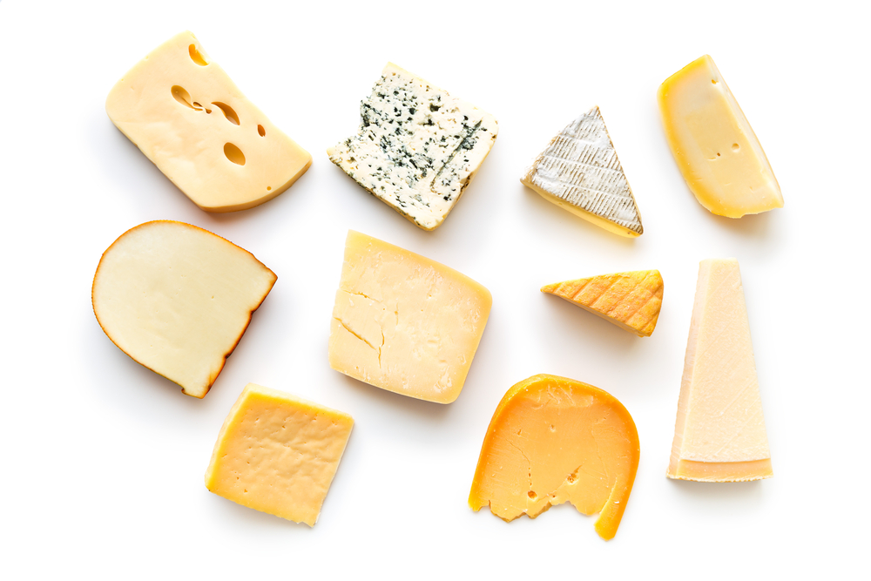
Cheese
There are many different types of cheese.
Cheese is made from milk.
Milk is usually from a cow, but can be from a sheep or goat.

Slide 3
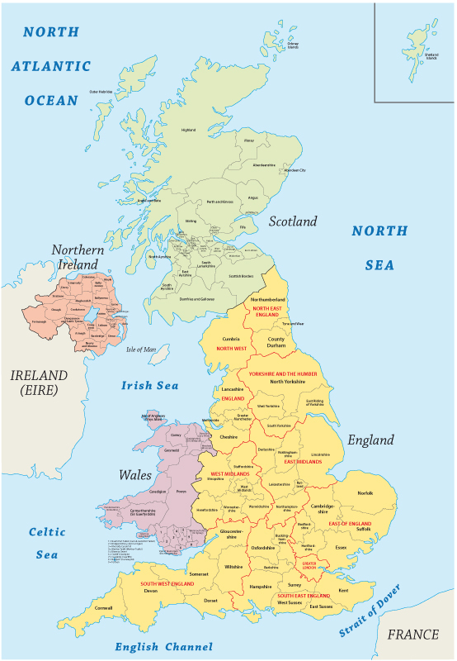
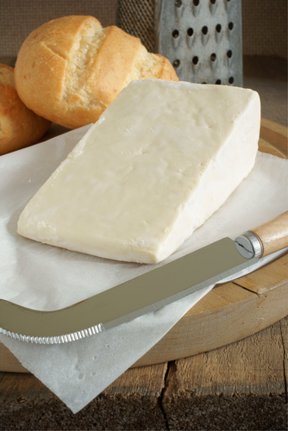
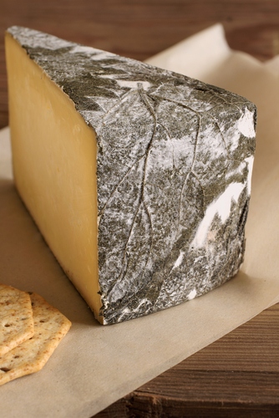
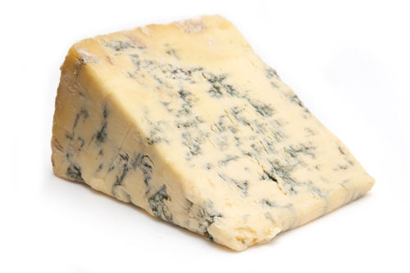
Around the UK
Here are some cheeses from the UK.
What other types can you name?
Stilton
Caerphilly
Cornish yarg

Slide 4
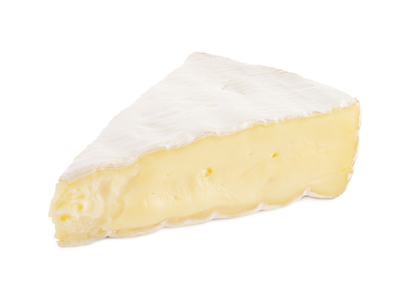
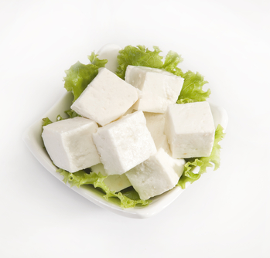
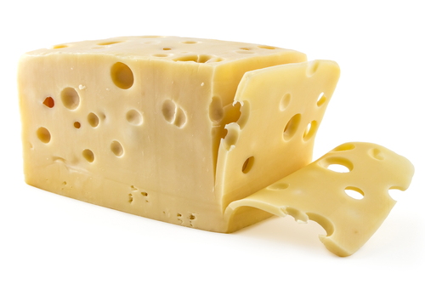
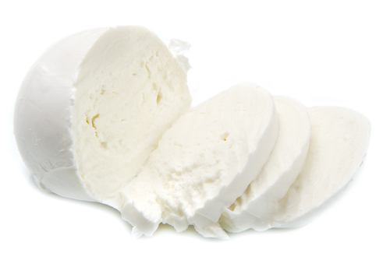
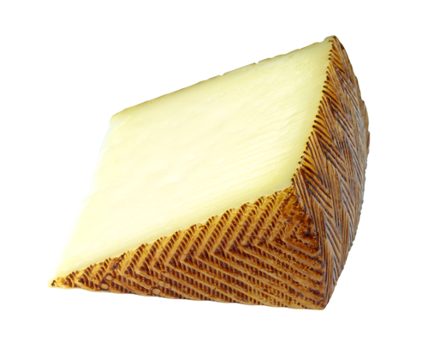
Around the world
Paneer (India)
Cheese is made around the world.
Here are five examples.
Name five more examples.
Brie (France)
Emmental (Switzerland)
Mozzarella (Italy)
Manchego (Spain)

Slide 5

Say cheese!

Slide 6
For further information, go to:
www.foodafactoflife.org.uk

